Slide 1
Analysis of Ford GoBike Trips, February 2019
Bryan Ho

Slide 2
Analysis Overview
Ford GoBike, now known as Bay Wheels, is a regional public bicycle sharing system in California's San Francisco Bay Area. This service allows people to pick up a bike from a station, ride the rented bike around the bay, and drop it off at another station.
The analysis in this slide deck will take into account all Ford GoBike trip data in February 2019. Recommendations for business decisions and further analysis will be included at the end of the slide deck.

Slide 3
Analysis Overview
The analysis performed in this investigation and included in this slide deck are:
Bike Station Bikes Surplus and Deficits
Bike Service Usage Per Hour and Weekday
Target Demographic
Geographical Usage

Slide 4
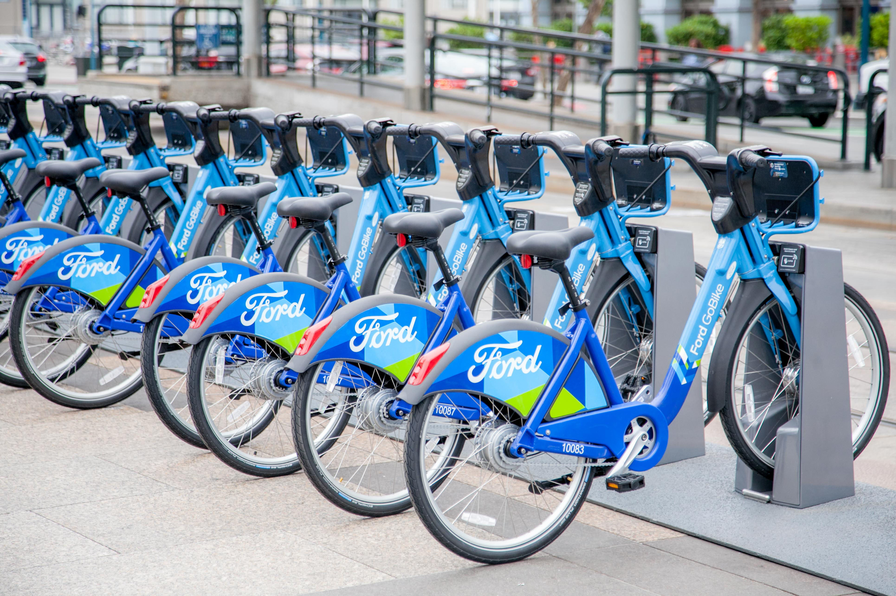
Bike Station Bikes Surplus and Deficits
As Ford GoBike service allows users to rent a bike from a station and return it to another station, we investigated the stations that had the highest difference in start_stations and end_stations.
A station with a high start count and low end count would indicate that users are taking bikes from the station more than bikes are being returned to the station - hence a bike deficit.
On the other hand, a low start count and high end count would indicate the opposite, a bike surplus.
https://www.digitaltrends.com/outdoors/ford-gobike-plus-san-francisco/

Slide 5
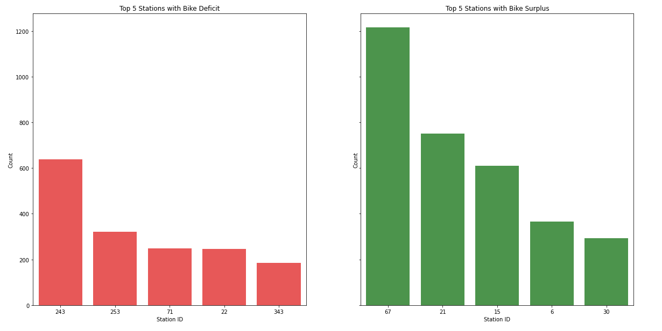
Bike Station Bikes Surplus and Deficits

Slide 6
Bike Station Bikes Surplus and Deficits
The top 5 stations with a deficit of bikes are station ID 243, 253, 71, 22 and 343.
The top 5 stations with a surplus of bikes are station ID 67, 21, 15, 6, 30.
Recommendation:
It is imperative that to continue to provide quality service, each station should have sufficient number of bikes to meet the demand. It is recommended that either more bikes are placed at the stations with the deficit. It is also recommended that the company allocates resource to redirect bikes from the stations with a surplus to the stations with the deficit.

Slide 7
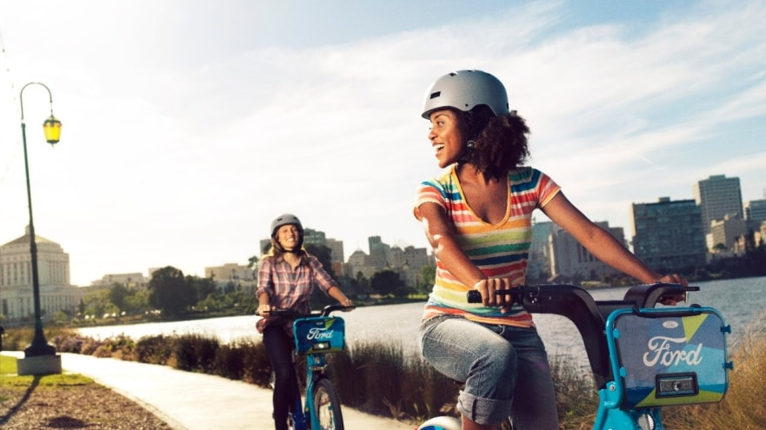
Bike Service Usage Per Hour and Weekday
To ensure sufficient customer service staffing, whether maintenance or on-call, we identified the highest peak usage of the bike service.
This analysis measured the total number of trips per hour and also per day of the week, for the given dataset (Feb 2019)
https://media.ford.com/content/fordmedia/fna/us/en/news/2017/06/27/ford-gobike-launching-in-bay-area-bike-sharing.html

Slide 8
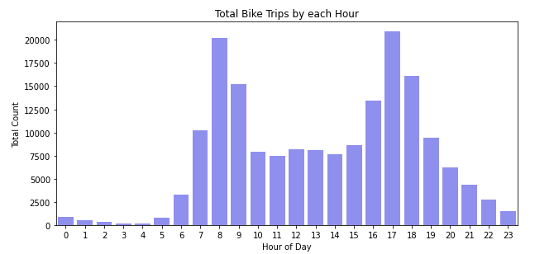
Bike Service Usage Per Hour and Weekday

Slide 9
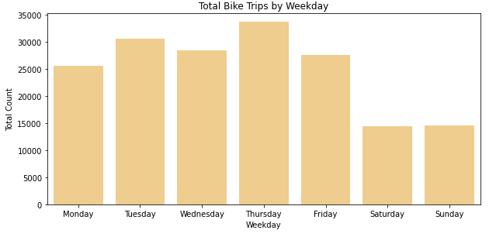
Bike Station Bikes Surplus and Deficits

Slide 10
Bike Station Bikes Surplus and Deficits
There are 2 peak usage hours of 8AM and 5PM (local time). This coincides with commute time for the standard 9-5 jobs, with 8AM being the commute to work and 5PM being the commute home. This sheds light on the type of consumer that is using our platform as many of our users use the bikes to get to work.
To reinforce the hypothesis, we have a high usage rate on the work weekdays (Monday-Friday) and a significantly lower usage on the weekends.
Recommendation:
As the current user group is largely the commuting work group, the company can tailor promotions towards this group (ie. monthly commuting pass)

Slide 11
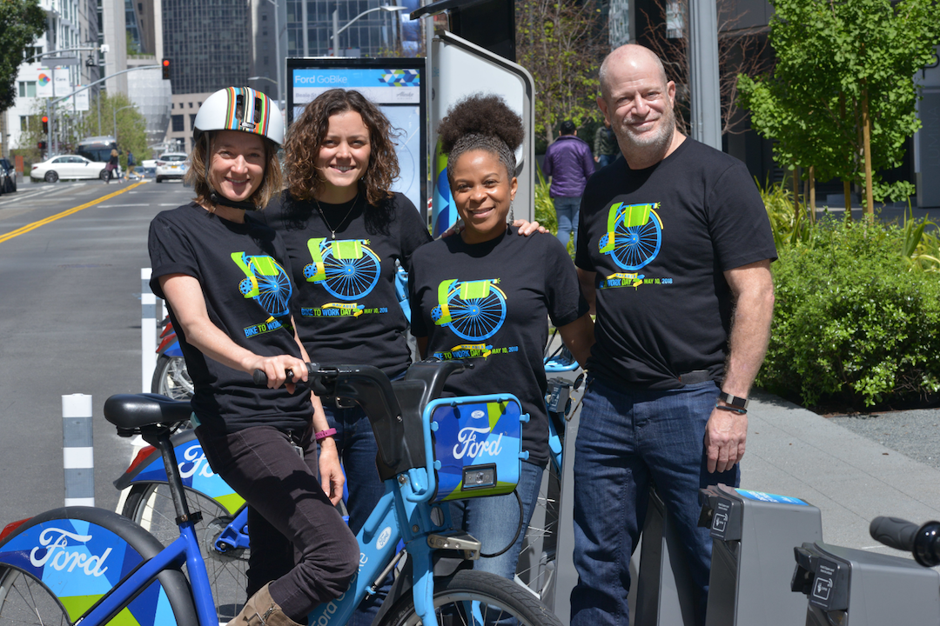
Target Demographic
The target demographic can provide insight on the consumer group that uses the bike service. This analysis looked into the birth year taken from the registered accounts’ info as well as the gender.
Note that any ages above 79 years old (birth year < 1940) was excluded as entries were either insignificant or due to data error.
https://mtc.ca.gov/whats-happening/news/dont-miss-bike-work-day-may-10

Slide 12
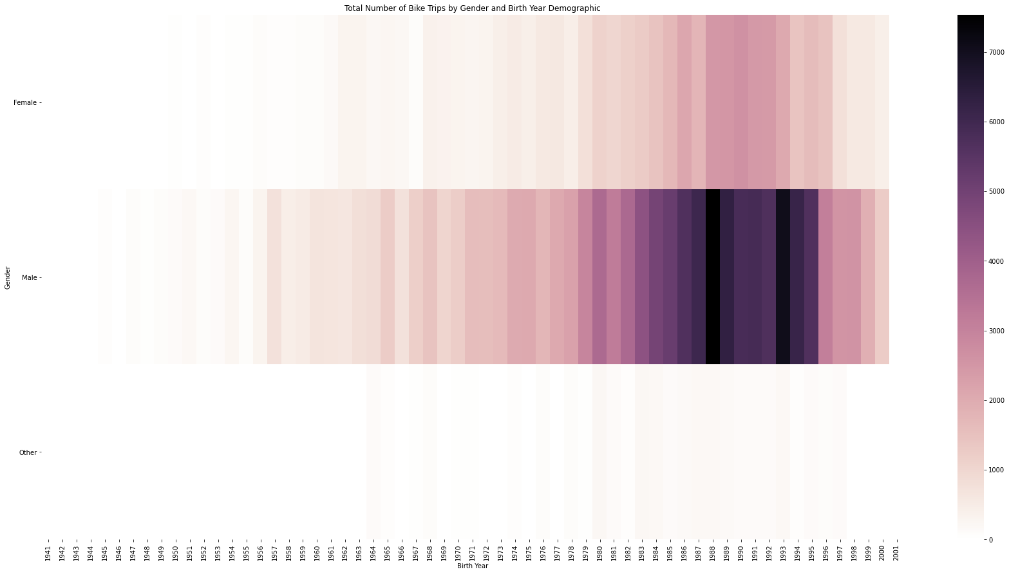
Target Demographic

Slide 13
Target Demographic
From the heatmap, it is evident that males are more likely to use the bike service than females. In addition, for all genders, the age group born between the mid 1980s to mid 1990s is the highest demographic group (coinciding with age group between 25-34)
Recommendation:
Ford Go Bike could look to provide services for older people (35+) to expand their market reach. This can also be applied to the female population as the number of female users is only half of the male users.

Slide 14

Geographical Usage
The last analysis was to investigate the geographical usage of the bike service. Identifying the hotspots where most of the users use the bike service can help us reallocate resources to support those areas better.
https://en.wikipedia.org/wiki/Bicycle_map

Slide 15
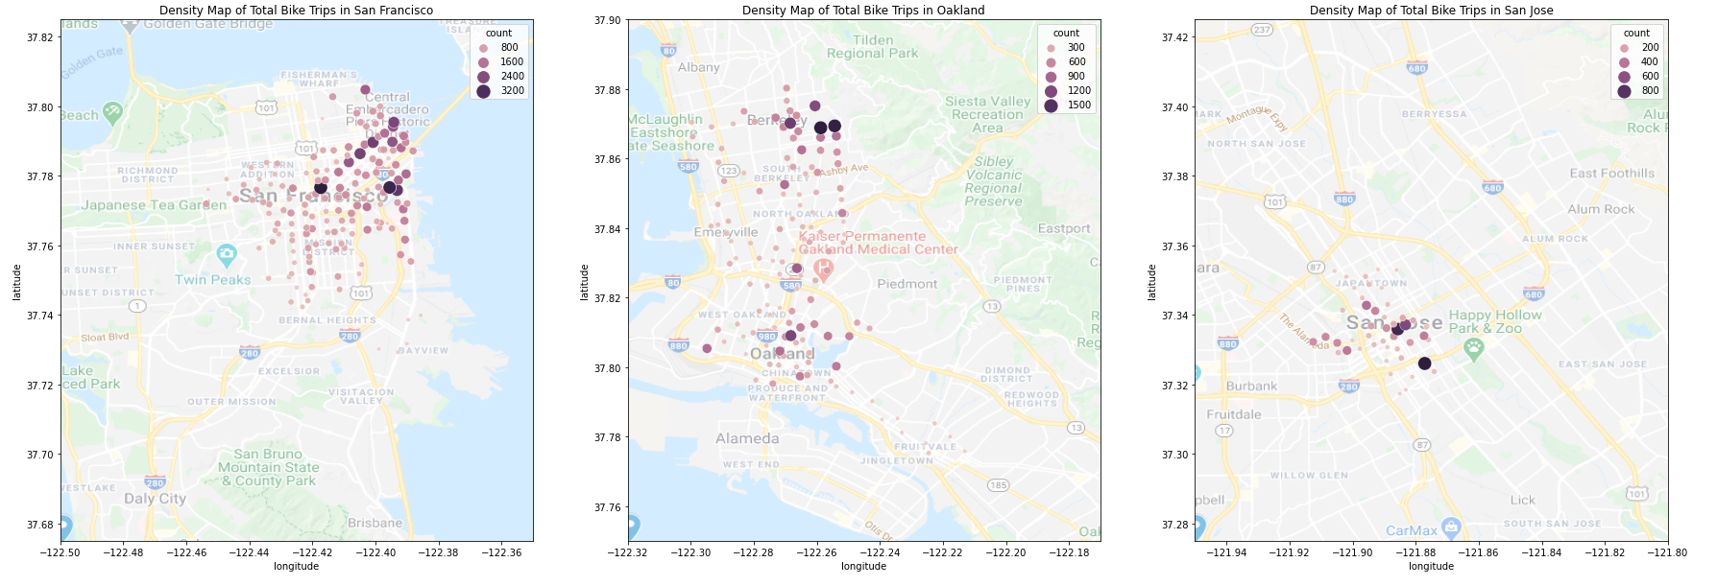
Geographical Usage

Slide 16
Geographical Usage
Currently, Ford GoBike only provides service in 3 cities: San Francisco, Oakland and San Jose.
We can see that in San Francisco, the bike service is mainly used on the north east of the city, around the downtown area and pier.
In Oakland, we have 2 hotspots - one in Berkeley and one in Oakland. However, there is still activity between the 2 cities.
Lastly, in San Jose, the usage is very localized in downtown San Jose.
Recommendation:
Support staff and services can be allocated to these regions to better support continuous bike service. In addition, in Oakland, there is a strong demand for the service between the cities of Oakland and Berkeley. This can be a possible area for future expansion.

Slide 17
Analysis Summary
The analysis performed in this investigation and included in this slide deck are:
Bike Station Bikes Surplus and Deficits
Bike Service Usage Per Hour and Weekday
Target Demographic
Geographical Usage
The recommendations from the analysis are:
Allocate resources to move bikes from stations with high surplus to stations with high deficit
Promotions should be targeted towards either commuters
Market expansion should be targeted towards females, 35+ years old people

